Slide 1
TECHNICAL WRITING STYLE
UNIT 5

Slide 2
OBJECTIVES
WRITE TECHNICAL DOCUMENTS IN SHORT AND SUMMARIZING STYLE
CONSTRUCT CLEAR SENTENCES
AVOID MISTAKES WHILE WRITING
RECOGNISE BRITISH AND AMERICAN ENGLISH
USE CONSISTENT STYLE IN TECHNICAL DOCUMENTS

Slide 3
CONCISE Communication
CONCISE AND DIRECT WRITING IS ESSENTIAL
LONGER DOCUMENTS-TAKES READER’S TIME
DIRECT WRITING
SENTENCE CONSTRUCTION
COMMON ERRORS WHILE CONSTRUCTING SENTENCES

Slide 4
1. DIRECT WRITING
AVOID LONG SENTENCES
FOCUS DIRECTLY ON THE SUBJECT
EXPRESS IDEAS IN STRAIGHTFORWARD STYLE
Examples of writing:
Before filling the gas tank, it is necessary to turn off the propane line to the refrigerator. Failure to do so significantly increases the risk of explosion
Before you fill gasoline into the gas tank, turn off the propane line to the refrigerator. If you do not turn off the propane tank, it could explode.

Slide 5
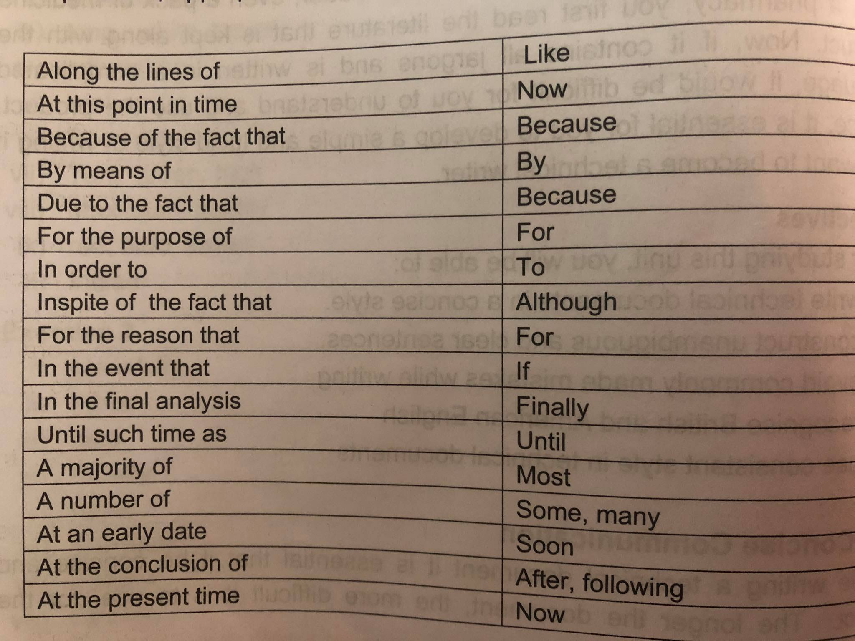

Slide 6
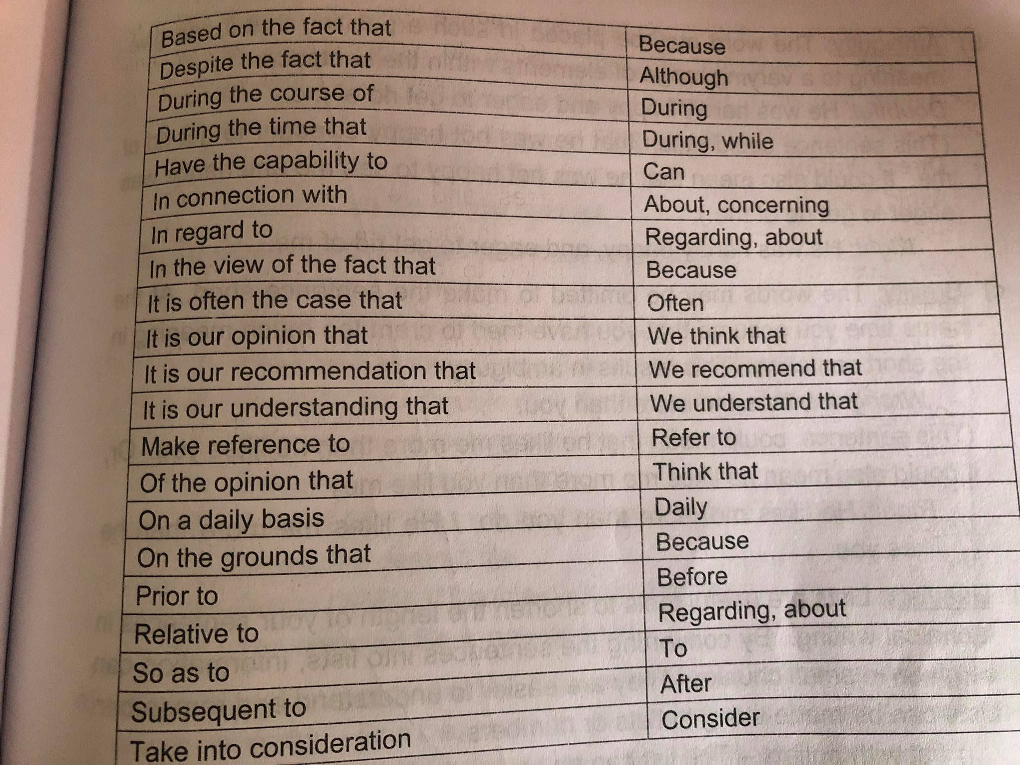

Slide 7
2. Sentence construction
Careful crafting of sentences is most important aspect of a TECHNICAL WRITER
Your writing has to be reader-friendly
WORD ORDER
Use correct words at the right place and right order
Right or wrong?
Now that you have read the manual of target practice, try shooting yourself.
Practice shooting, now that you have read the manual of target practice.
Write down the procedure of electroplating on a postcard.
Write down on a post card the procedure of electroplating.

Slide 8
B. USE LISTS
Very useful to shorten length of sentences in technical writing
By converting sentences into lists, information can be given in short
They are easier to understand and remember
List with bullets: no specific order
List with numbers: order needs to be followed
Avoid long lists
Avoid including more than 10 items in the list
If more required, divide list
C. EMPHASISE MOST IMPORTANT
Place the main information in your sentences at the end
The performance of the camera will be superb in all function modes.
In all function modes, the performance of the camera will be superb.

Slide 9
3. COMMON ERRORS WHILE CONSTRUCTING SENTENCES
A. SHIFT IN TENSE AND PERSON
Beginning a sentence or paragraph in one tense and ending it in another tense
He did not have to apologized for being late at the meeting.
He did not have to apologize for being late at the meeting.
B. INCORRECT USE OF APOSTROPHE
Apostrophe is used either to indicate possession or contraction
Manager’s car
Telephone weren’t working

Slide 10
Clarity and precision
Technical document has to be clear and correct
Use short and simple words/language to relate
Break the document into different paragraphs when discussing more than 1 point
Use transitional words or phrases
To begin with, first of all, after that, then, firstly, secondly, finally
Furthermore, in addition, moreover, likewise, similarly, for instance, hence, therefore
Repeat key words
Main point has to be repeated in the document
New screening techniques are being developed to combat viral infections. These techniques are the subject of a new research effort in California.

Slide 11
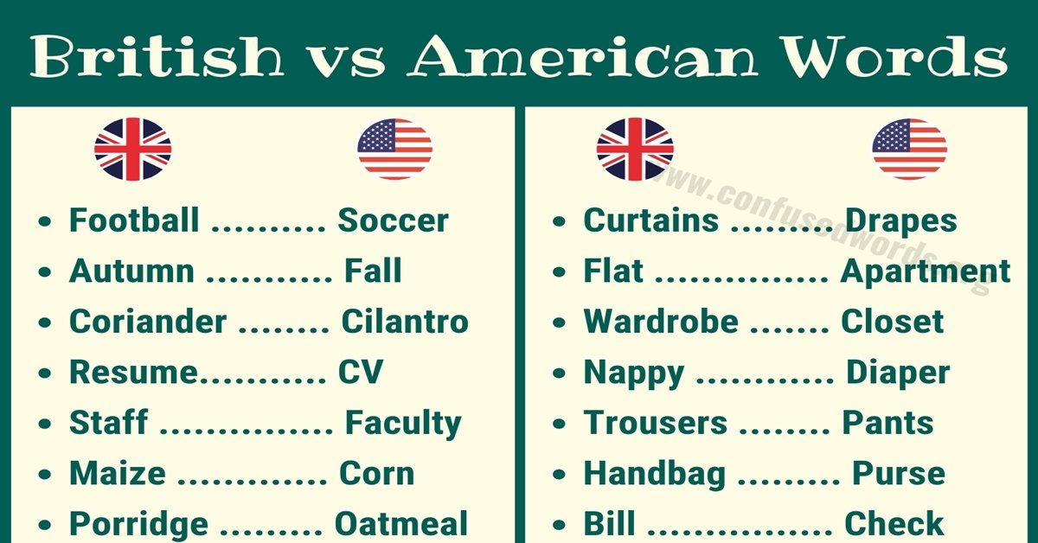
AMERICAN AND BRITISH ENGLISH
American English is form of English written and used in America
British English if form of English written and used in United Kingdom
Main difference can be found in pronunciation and vocabulary (spelling)

Slide 12
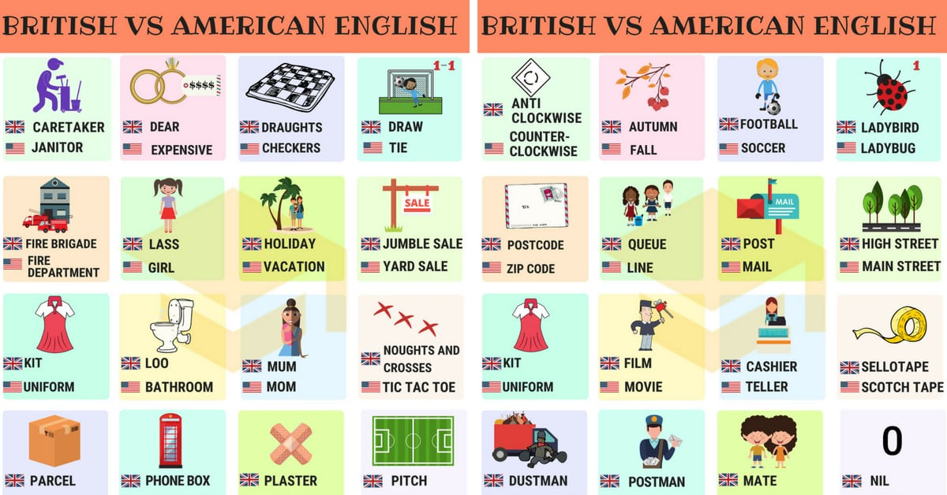
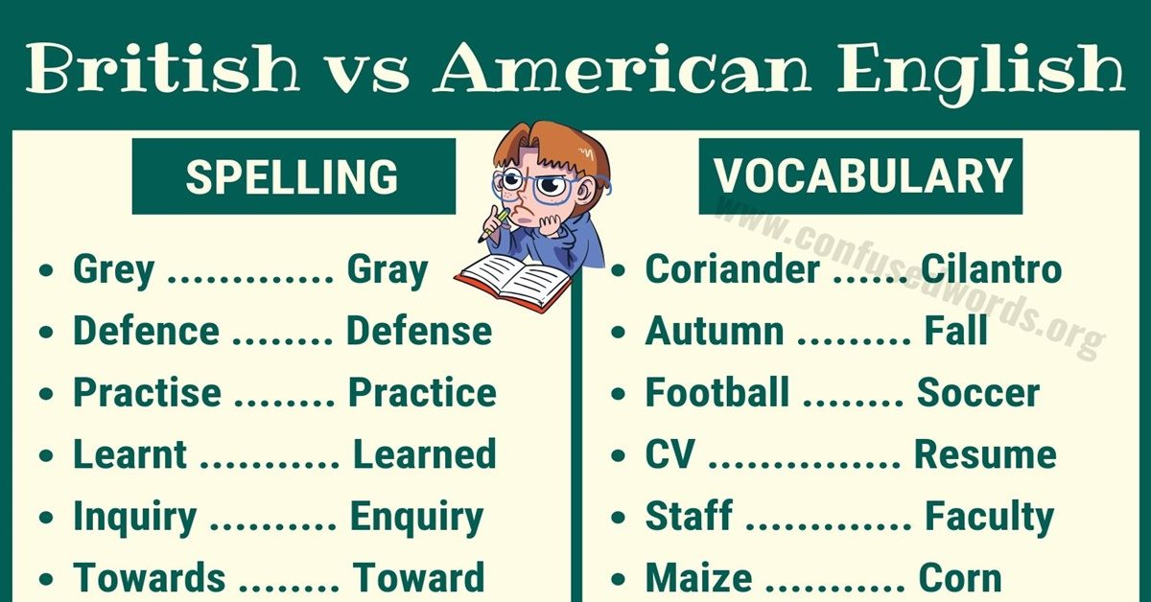

Slide 13
STYLE MANUAL
Some general styles which have to be followed
NUMBERS
Spell number from one to ten
For numbers more than 10, use numerical instead of words
There are 22 computers in our office out of which five are Mac.
ABBREVIATIONS
You can use words from the initials after you have referred to them earlier (In the first usage the full form should be given) e.g. AIDS (Acquired Immuno Deficiency Syndrome)
You can abbreviate Jan, Feb, Aug, Oct when they are used as dates. e.g. Oct 6, 2020

Slide 14
TAKE HOME ASSIGNMENT
WRITE A TECHNICAL DOCUMENT-SUMMARY ON “YOUR PD ASSIGNMENT”
MAKE USE OF TECHNICAL WRITING STYLE LEARNT IN THIS UNIT

